Slide 1

CompTIA Security+ Certification - SYO-601 Exam Training

Slide 2


Domain 1: Attacks, Threats, and Vulnerabilities

Slide 3
Comparing Security Roles and Controls

Slide 4


Learning Objectives
By the end of this lesson, you will be able to:
Compare information security roles
Categorize security frameworks and controls
Analyze cybersecurity framework
Interpret ISO and cloud frameworks

Slide 5

Compare and Contrast Information Security Roles

Slide 6
Information Security
Confidentiality
Data is known or accessed only by certain individuals.
Availability
Data is available to those who can view or edit it.
Integrity
Data is stored and transferred in the intended manner with authorized changes.
CIA Triad
Non-repudiation
A subject cannot deny something that has been done.

Slide 7

Cybersecurity Framework
NIST (National Institute of Standards and Technology) defines a framework for synchronous information security practices. This framework includes:
Identify
Detect
Recovery
Protect
Respond

Slide 8










Cybersecurity Framework
This is an architectural diagram with cybersecurity framework components.
Identify
External defence
Internal
defence
Protect
Attack
Detect
Respond
Recover
Internal threats
Attack
External threats

Slide 9


Information Security Roles and Responsibilities
Different roles and responsibilities in information security domain include:
A dedicated safety department is headed by the Security Director. It may be the Chief Security Officer (CSO) or Chief Information Security Officer (CISO).
Domain managers are in charge of building management, IT, or accounting.

Slide 10


Information Security Roles and Responsibilities
Information Systems Security Officer (ISSO) must comply with policy and any applicable legislations.
All employees share a certain level of responsibility toward the security of the systems.

Slide 11







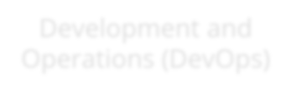







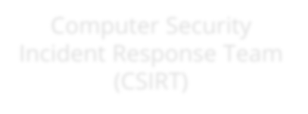
Information Security Business Units
The commonly used terms in information security are shown below.
Security Operations Center (SOC)
Information Security
Business Units
Development and Operations (DevOps)
Cyber Incident Response Team (CIRT)
Incident Response
Computer Emergency
Response Team (CERT)
Computer Security Incident Response Team (CSIRT)

Slide 12
Compare and Contrast Security Control and Framework Types

Slide 13










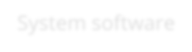






Security Control Categories
Security controls are classified into three categories:
Security control categories
Technical
Operational
Managerial
System software
Managed by person
Control of entire system
Application software
Other security appliances

Slide 14
Security Control Functional Types
There are six functional types in security control. They are:
Preventive
Apply before the threat
Use it to prevent unauthentic access
Detective
Search and log the management of attack
Active during the attack
Corrective
Apply recovery and preventive approach during and after the attack

Slide 15
Security Control Functional Types
Physical
Hardware access permissions that deter an attacker using alarm, locks, etc.
Deterrent
Social or psychologically method that demotivates an attacker from attempting an attack.
Compensating
Replacement of control with the one that offers the same level of security while using a specific method or technology.

Slide 16
NIST Cybersecurity Framework
Function unique identifier | Functions | Category unique number | Category
ID | Identify | ID.AM | Asset Management
 |  | ID.BE | Business Environment
 |  | ID.GV | Governance
 |  | ID.RA | Risk Assessment
 |  | ID.RM | Risk Management Strategy
PR | Protect | PR.AC | Access Control
 |  | PR.AT | Awareness and Training
 |  | PR.DS | Data Security
 |  | PR.IP | Information Protection Processes and Procedures
 |  | PR.MA | Maintenance
 |  | PR.PT | Protective Technology

Slide 17
NIST Cybersecurity Framework
Function unique identifier | Functions | Category unique number | Category
DE | Detect | DE.AE | Anomalies and Events
 |  | DE.CM | Security Continuous Meeting
 |  | DE.DP | Detection Processes
RS | Respond | RS.RP | Response Planning
 |  | RS.CO | Communications
 |  | RS.AN | Analysis
 |  | RS.MI | Mitigation
 |  | RS.IM | Improvements
RC | Recover | RC.RP | Recovery Planning
 |  | RC.IM | Improvements
 |  | RC.CO | Communications

Slide 18



ISO and Cloud Frameworks
ISO/IEC 27001 is the best-known Information Security Management System (ISMS). It provides the following requirements:
International Organization for Standardization (ISO)
Cloud Security Alliance
ISO 27001 information security standards
Security guidance for Cloud Service Providers (CSPs)
ISO 31000 Enterprise Risk Management (ERM)
Enterprise reference architecture
Cloud controls matrix

Slide 19
ISO and Cloud Frameworks
Statements on Standards for Attestation Engagements (SSAE) and Service Organization Control (SOC):
SOC2 evaluates service provider
Type I report assesses system design
Type II report assesses ongoing effectiveness
SOC3 public compliance report

Slide 20

Regulations, Standards, and Legislation
The critical frameworks and configuration guides used to demonstrate compliance include:
Due Diligence
Sarbanes-Oxley Act (SOX)
Computer Security Act (1987)
Federal Information Security Management Act (FISMA)
General Data Protection Regulation (GDPR)

Slide 21
Regulations, Standards, and Legislation
National, Territory, or State Laws
Gramm–Leach–Bliley Act (GLBA)
Health Insurance Portability and Accountability Act (HIPAA)
California Consumer Privacy Act (CCPA)
Payment Card Industry Data Security Standard (PCI DSS)

Slide 22
Key Takeaways
NIST defines a framework for synchronous information security practices.
IEC 27001 is the best-known information security
management system.
SOC is a location where safety experts monitor and protect critical information of business functions.
Incident response is a single point of contact for security incident notifications.

Slide 24
Threat Actors and Threat

Slide 25
Learning Objectives
By the end of this lesson, you will be able to:
List the types of threat actors and attack vectors
Illustrate threat intelligence sources
Explain state actors and advanced persistent threats
Discuss artificial intelligence and predictive analysis

Slide 26
Types of Threat Actors and Attack Vectors

Slide 27

Vulnerability
Vulnerability refers to condition in the system that intentionally or by accident causes a security disability. This compromises the security of the system.

Slide 28

Threat
A potential threat is a threat actor or a potential threat agent.
The act of an attacker, either violent or clever, can be defined as the vector of attack.
2
Issues may prevail if someone or something tries to manipulate a vulnerability.
Threats should be taken seriously regardless of the source.
1
3

Slide 29

Risk
Risk is the exploitation of a security vulnerability by threat agents.
1
2
Every threat actor exploits a security liability if there is a high probability and significant cost of failure associated with it.
Vulnerability can be recognized to
calculate the effect of an attack.
Vulnerability + Threat = Risk

Slide 30
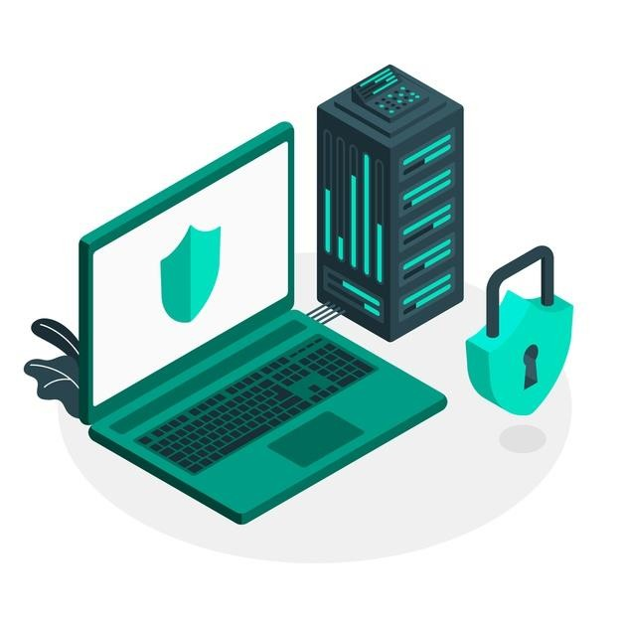
Cybersecurity Techniques: Features
Cybersecurity is vital to protect data of all types against theft and damage.
Cybersecurity techniques have traditionally been heavily
dependent on identifying static threats.
01
02
Identifying and scanning threats with automated software is relatively straightforward.
The sophisticated nature of modern cybersecurity threats indicate that behavior can be described and analyzed.
03

Slide 31
Attributes of Threat Actors
Threat analysis is the process of identifying the attributes of a threat with respect to:
01
02
03
Location
Intent or Motivation
Capability

Slide 32

Location
Location threat actors can be classified as:
External threat actor
Does not have a target system account or authorized access
Internal threat actor
Has authorized access to internal systems

Slide 33
Intent or Motivation
Intent describes what an assailant assumes that the attack can achieve, while motivation is the reason for committing the attack.
Threats can be characterized as structured or unstructured.
The accidental actors and agents of threats can contrast malicious intentions and motivations.

Slide 34
Capability of Resources
A threat actor can produce new techniques and instruments.
01
The least capable threat relies on tools that can be accessed generally on the web or the dark web.
Sophisticated threats must be able to acquire resources, including customized tools.
02
04
03
More agents in operating systems, application software, and embedded control systems can initiate zero-day achievements.

Slide 35





Hackers
Hacker refers to a person who has unauthorized or unapproved access to computer systems.
The hacker was initially used as a neutral term for a user who excelled in the programming and administration of computer systems.
Three major types of hackers are:
White Hat
Black Hat
Gray Hat

Slide 36


Script Kiddies
A script kiddie is someone who uses hacker tools without necessarily comprehending how they work or possessing the ability to create new attacks.
Script kiddie attacks may have no specific objective or rationale, other than gaining attention or demonstrating technical proficiency.

Slide 37
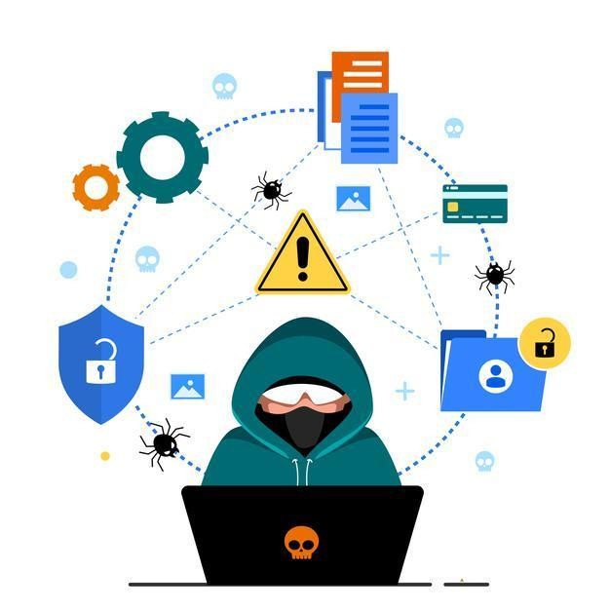
Hacktivists
Hacktivists are active users with complete knowledge of hacking. They release hacked information over public platforms.

Slide 38
Hacktivists
Hacktivists may attempt to obtain and publicly release confidential information, conduct Denial of Service (DoS) attacks, or deface websites.
A hacktivist organization, such as Anonymous, Wikileaks, or LulzSec, employs cyber weapons to advance a political agenda.
Political, media, and finance are the frequently targeted groups.

Slide 39

State Actors and Advanced Persistent Threat
The characteristics of a state actor are listed below:
State-backed groups
Advanced Persistent Threat (APT)
Espionage and Strategic advantage
Deniability
False Flag Operations
Source: http://media.kasperskycontenthub.com/wp-content/uploads/sItes/43/2019/11 /20 151759/KSB2019_APT-predictions-2020_web.pdf

Slide 40

Criminal Syndicates
Cybercrime has surpassed physical crime in several countries, both in terms of incidents and losses.
01
Operated across legal jurisdictions
02
Motivated by criminal profit
03
Well resourced and funded

Slide 41
Competitors
Competitor-driven espionage is believed to be conducted by state actors. It is not implausible that a rogue business would engage in cyber espionage against its competitors:
01
02
Cyber espionage
Insider threat

Slide 42

Insider Threat Actors
Malicious insider threat actor:
01
Has or had authorized access
02
Includes employees, contractors, partners
03
Is involved in sabotage, financial gain, or
business advantage

Slide 43
Insider Threat Actors
Examples of unintentional insider threats:
Weak policies and procedures
Lack of training or security awareness and shadow IT
01
03
02
Weak adherence to policies and procedures

Slide 44

Attack Vectors
A threat actor's attack vector is the path taken to gain access to a secure system.
Gaining access entails to execute malicious code on the target system. The access can be:
Direct access
This type of attack is physical or local in nature. The threat actor could exploit an unlocked workstation, attempt to install malicious software via a boot disc, or steal the device.

Slide 45


Attack Vectors
Removable media
The attacker hides malware on a USB thumb drive or memory card and attempts to dupe employees into connecting the media to a PC, laptop, or smartphone.
Email
The attacker sends a malicious file attachment via email or another attachment-enabled communication system.

Slide 46


Attack Vectors
Remote and wireless
Either the attacker obtains credentials for remote access or wireless connection to the network, or the attacker cracks the authentication security protocols.
Supply chain
Rather than directly attacking a target, a threat actor may seek to infiltrate it through companies in the target's supply chain.

Slide 47


Attack Vectors
Web and social media platforms
Malware can be hidden in files attached to posts or presented as downloads.
Cloud computing
Since many businesses operate a portion or the entire network services via Internet-connected clouds, attackers target these services.

Slide 48
Threat Intelligence Sources

Slide 49
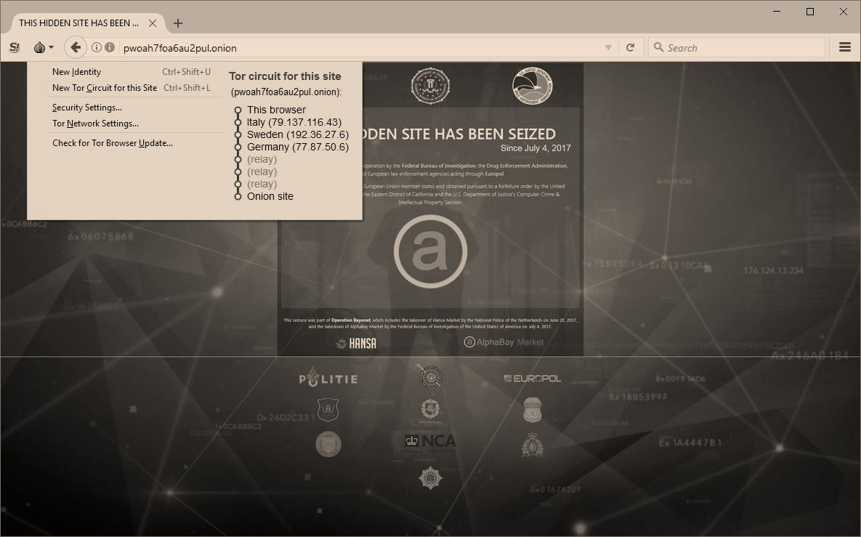
Threat Research Sources
Threat research offers a detailed and analyzed information about the incidence that includes all past and present security threat information.

Slide 50
Threat Research Sources
Cyber Security Research Agencies
Universities/Academic Institutions
It offers counterintelligence efforts that includes TTPs and:
Organizations Using Honeynet
Dark Net and Dark Web

Slide 51
Threat Intelligence Providers
The results of primary research conducted by security solution providers and academics are classified into three types:
Behavioral threat research consists of a narrative commentary that describes the examples of attacks and TTP gathered from primary sources.
Reputational threat intelligence includes lists of IP addresses and domains linked to malicious activity.
Threat data computer information is used to link activities detected
on a customer's networks and logs.

Slide 52
Threat Intelligence Providers
The different threat intelligence providers are listed below:
Closed or Proprietary
The threat research and CTI data were made available via a commercial threat intelligence
portal as a paid subscription.
Websites of vendors
As a general benefit to their customers, all forms of defence, hardware, and software vendors make extensive threat research accessible on their websites.

Slide 53
Threat Intelligence Providers
Public or Private information sharing centers
Information Sharing and Analysis Centers (ISACs) have been developed in many critical
industries to exchange threat intelligence and encourage best practices.
Open-Source Intelligence (OSINT)
Some organizations provide threat intelligence services as an open-source project, with revenue derived from consulting, rather than from the network or analysis initiative.

Slide 54
Tactics, Techniques, and Procedures
Tactics, Techniques, or Process (TTP) broadly describe an adversary’s behavior.
Generalized statement of adversary
behavior
Specific intrusion tools and methods (procedures)
Campaign strategy and approach
(tactics)
Generalized attack vectors
(techniques)

Slide 55
Indicators of Compromise
Rundown of some IoCs:
Individual data points
AI-backed analysis
01
02
03
04
05
Specific evidence of intrusion
Correlation of system and threat data
Indicator of Attack (IoA)

Slide 56
Artificial Intelligence and Predictive Analysis
Predictive analysis in AI provides correlation between security intelligence or event monitoring and threat data.
Artificial Intelligence (AI) and Machine Learning (ML) contains:
Artificial Neural
Networks (ANN)
Expert systems

Slide 57
Artificial Intelligence and Predictive Analysis
Predictive analysis includes:
Threat forecasting
Monitor “chatter”
1
2

Slide 58
Key Takeaways
Vulnerability refers to a condition in the system that intentionally or by accident causes a security disability. This compromises the security of the system.
Threat analysis is a process of identifying the attributes of a threat with respect to its location, social, and managerial capabilities.
Threat research offers a detailed and analyzed information about the incidence that includes all past and present security threat information.
Predictive analysis in AI provides correlation between security intelligence/event monitoring and threat data.

Slide 60
Performing Security Assessments

Slide 61
Learning Objectives
By the end of this lesson, you will be able to:
Perform network security audits using network audit tools Identify the general security concerns
Classify the techniques for vulnerability scanning
Interpret the theory behind penetration testing

Slide 62
Assess Organizational Security with Network Reconnaissance Tools

Slide 63



Footprinting Network Layout Detection
Footprinting network layout and rogue system detection can be done using:
ipconfig/ifconfig/ip
Command Prompt
C:\Users\Deepak>ipconfig Windows IP Configuration
This code is used to report the local IP configuration.
Ethernet adapter Ethernet:
Media State . . . . . . . . . . . : Media disconnected Connection-specific DNS Suffix . :
Ethernet adapter Npcap Loopback Adapter:
Connection-specific DNS Suffix . :
Link-local IPv6 Address . . . . . : fe80::d5a8:1bc8:8b37:d749%24 Autoconfiguration IPv4 Address. . : 169.254.215.73
Subnet Mask . . . . . . . . . . . : 255.255.0.0
Default Gateway . . . . . . . . . :

Slide 64



Using Ping Sweep to Test Connectivity
Ping sweep tests the connectivity with a host to detect the hive hosts on subnet using the below code:
Command Prompt
C:\Users\Deepak>ping 192.168.1.1
Pinging 192.168.1.1 with 32 bytes of data:
Reply from 192.168.1.1: bytes=32 time=10ms TTL=64 Reply from 192.168.1.1: bytes=32 time=3ms TTL=64 Reply from 192.168.1.1: bytes=32 time=4ms TTL=64 Reply from 192.168.1.1: bytes=32 time=2ms TTL=64
Ping statistics for 192.168.1.1:
Packets: Sent = 4, Received = 4, Lost = 0 (0% loss),
Approximate round trip times in milli-seconds: Minimum = 2ms, Maximum = 10ms, Average = 4ms

Slide 65



Address Resolution Protocol Cache
The given code shows the Address Resolution Protocol (ARP) cache, IP to Media Access Control (MAC) address mapping, and detects spoofing.
Command Prompt
C:\Users\Deepak>arp -a Interface: 192.168.43.126 --- 0x4
Internet Address | Physical Address | Type
192.168.43.8 | 04-92-26-a2-39-Of | dynamic
192.168.43.255 | ff-ff-ff-ff-ff-ff | static
224.0.0.22 | 01-00-5e-00-00-16 | static
224.0.0.251 | 01-00-5e-00-00-fb | static
224.0.0.252 | 01-00-5e-00-00-fc | static
239.255.255.250 | 01-00-5e-7f-ff-fa | static
255.255.255.255 | ff-ff-ff-ff-ff-ff | static

Slide 66


Route and Traceroute
Command Prompt
C:\Users\Deepak>route PRINT
================================================================
Interface List
2...10 7d la 3a 7c 39 ......Realtek PCIe GBE Family Controller 24...02 00 4c 4f 4f 50 ......Npcap Loopback Adapter
9...ea 9e b4 13 69 6b ......Microsoft Wi-Fi Direct Virtual Adapter #3 19...fa 9e b4 13 69 6b ......Microsoft Wi-Fi Direct Virtual Adapter #4 17...00 50 56 c0 00 01 ......VMware Virtual Ethernet Adapter for VMnet1
5...00 50 56 c0 00 08 ......VMware Virtual Ethernet Adapter for VMnet8 4...ea 9e 57 13 ae 74 ......Qualcomm QCA9377 802.11ac Wireless Adapter 23...e8 9e b4 13 69 6c ......Bluetooth Device (Personal Area Network) 1...........................Software Loopback Interface 1
================================================================
iPv4 Route Table
================================================================

Slide 67



Route and Traceroute
Command Prompt
==============================================================================
Active Routes:
Network Destination | Netmask | Gateway | Interface | Metric
0.0.0.0 | 0.0.0.0 | 192.168.43.8 | 192.168.43.126 | 55
127.0.0.0 | 255.0.0.0 | On-link | 127.0.0.1 | 331
127.0.0.1 | 255.255.255.255 | On-link | 127.0.0.1 | 331
127.255.255.255 | 255.255.255.255 | On-link | 127.0.0.1 | 331
169.254.0.0 | 255.255.0.0 | On-link | 169.254.57.177 | 291
169.254.0.0 | 255.255.0.0 | On-link | 169.254.216.90 | 291
169.254.0.0 | 255.255.0.0 | On-link | 169.254.215.73 | 281
169.254.57.177 | 255.255.255.255 | On-link | 169.254.57.177 | 291
169.254.215.73 | 255.255.255.255 | On-link | 169.254.215.73 | 281
169.254.216.90 | 255.255.255.255 | On-link | 169.254.216.90 | 291
169.254.255.255 | 255.255.255.255 | On-link | 169.254.57.177 | 291
169.254.255.255 | 255.255.255.255 | On-link | 169.254.216.90 | 291
169.254.255.255 | 255.255.255.255 | On-link | 169.254.215.73 | 281
192.168.43.0 | 2 55.255.255.0 | On-link | 192.168.43.126 | 311
192.168.43.126 | 255.255.255.255 | On-link | 192.168.43.126 | 311
192.168.43.255 | 255.255.255.255 | On-link | 192.168.43.126 | 311
224.0.0.0 | 240.0.0.0 | On-link | 127.0.0.1 | 331
224.0.0.0 | 240.0.0.0 | On-link | 169.254.57.177 | 291
224.0.0.0 | 240.0.0.0 | On-link | 169.254.215.73 | 281
224.0.0.0 | 240.0.0.0 | On-link | 169.254.216.90 | 291
224.0.0.0 | 240.0.0.0 | On-link | 192.168.43.126 | 311
255.255.255.255 | 255.255.255.255 | On-link | 127.0.0.1 | 311
255.255.255.255 | 255.255.255.255 | On-link | 169.254.57.177 | 291
255.255.255.255 | 255.255.255.255 | On-link | 169.254.215.73 | 281
255.255.255.255 | 255.255.255.255 | On-link | 169.254.216.90 | 291
255.255.255.255 | 255.255.255.255 | On-link | 192.168.43.126 | 311
==============================================================================

Slide 68
Route and Tracert
route
pathping/mtr
Shows the local routing table
Identifies default route and local subnet
Checks for suspicious entries
Provides latency and packet loss statistics along a route over a longer time
Uses Pathping as a tool for Windows
tracert
traceroute
ICMP reports hops between local host and remote host
Provides hosts for Round Trip Time (ROTT)
Carries out Linux host route discovery
Uses UDP but not CMP

Slide 69
IP Scanners and Nmap
The flexibility of Nmap enables a user to scan single goals, whole subnetworks, partial subnetworks, target file lists, or command Nmap to create random targets or detect possible goals in a network according to or arbitrarily specific conditions.
Host discovery
Port scan
Test whether host in IP range responds to probes
Test whether TCP or UDP port allows connections

Slide 70
Nmap
Nmap is a network scanning tool that uses IP packets to locate all connected devices and provide information on the running services and operating systems.
The software is available for a variety of operating systems, including Linux, Free BSD, Gentoo, and is commonly used via a command-line interface.
Nmap was designed for large-scale networks and can search thousands
of connected devices.

Slide 71
Uses of Nmap
Nmap is used to provide accurate, real-time information on the networks and the connected devices on a realistic level.
Displays a list of active hosts and open ports
02
Provides comprehensive information on each IP 01
active on a network
Provides details about scanning servers to identify vulnerabilities
03

Slide 72

Uses of Nmap
The following networks can be scanned using Nmap:
Connected devices
Enterprise-scale networks
IoT devices
Small-business networks

Slide 73
Characteristics of Nmap
Offers resources that are familiar to system administrators from other programs
Combines a variety of resources into a single program
Needs command-line interfaces to function

Slide 74
Service Discovery and Nmap
Service discovery determines the operating system and network services in use. It also determines the application software that is underpinning these services.
Service discovery can be used defensively to search for possible rogue
systems and unauthorized network service ports.
Nmap reports the state of each port scanned for each IP address in the scope when it completes a host discovery search.

Slide 75
Service Discovery and Nmap
Popular choices for service discovery scans include:
TCP SYN (-sS)
UDP scans (-sU)
Scanning host requests a link but does not acknowledge it.
This command scans UDP ports. Both UDCP and TCP scans can be mixed.
Port range (-p)
This command scans 1000 commonly used ports by default.

Slide 76


Service Discovery and Nmap
Nmap users can detect services, versions, and fingerprint in an operating system.
Fingerprinting is used to describe a systematic examination of services on a specific host.

Slide 77

Service Discovery and Nmap
Once resources have been identified, users can use Nmap with the -sV or -A switch to probe a host in detail and explore:
Fingerprinting in each port
Application name or version
Protocol
OS form or version
Device type

Slide 78

Operations of netstat
Basic operation of netstat:
Report port status on local machine
Switch to filter by
protocol
Display process name or PID that opened the port

Slide 79



Operations of nslookup
Basic operation of nslookup and dig include:
Name server querying
Zone transfers
Command Prompt
C:\Users\Administrator>netstat : findstr "10.1.0"
TCP TCP TCP TCP TCP TCP TCP TCP TCP TCP TCP
10.1.0.1:80
10.1.0.1:80
10.1.0.1:135
10.1.0.1:135
10.1.0.1:139
10.1.0.1:445
10.1.0.1:49154
10.1.0.1:49155
10.1.0.1:49158
10.1.0.1:49159
10.1.0.1:49163
ROGUE:1415 GATEWAY:49161 ROGUE:1417
ROGUE:ms-sql-s ROGUE:1418 10.1.0.134:49226 ROGUE:146?
ROGUE:1468 ROGUE:1469 ROGUE:1470 ROGUE:1471
TIME_WAIT ESTABLISHED TIME_WAIT TIME_WAIT TIME_WAIT ESTABLISHED ESTABLISHED ESTABLISHED ESTABLISHED ESTABLISHED ESTABLISHED
C:\Users\Administrator>_

Slide 80
Types of nslookup
The different types of nslookup tools are:
theHarvester
dnsenum
theHarvester is a platform for collecting Open-Source Intelligence (OSINT) for a specific domain or business name.
dnsenum is a tool that combines
several checks into a single query.
scanless
It is type of tool that can be used defensively by searching for ports and services that are not available.

Slide 81

Packet Capture
Packet and protocol analysis is crucial for security assessment and monitoring process. Sniffer is a tool for capturing network frames and it:
Uses a software to interact with host network driver (libpcap/winpcap)
Contains mirrored ports and SPAN
Uses a Test Access Port (TAP) device to read frames from network media
Enables placement of sensors

Slide 82
Packet Capture
tcpdump is another tool used for packet capture. It helps to:
Write a pcap
Read from pcap
Apply
filters

Slide 83

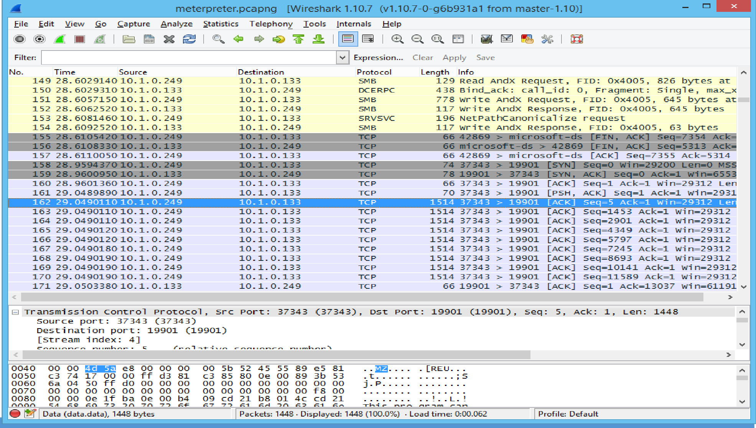
Packet Analysis and Wireshark
To perform traffic analysis, a protocol analyzer (or packet analyzer) collaborates with a sniffer to analyze a live capture or opening a saved capture (.pcap) file.

Slide 84

Packet Analysis and Wireshark
Steps for packet analysis include:
Go to output panes
1
Follow TCP Stream
2
Capture and display filters
4
3
Change coloring rules

Slide 85

Packet Injection and Replay
Packet injection is used for crafting spoofed packets that include:
Dsniff
Ettercap
Scapy

Slide 86
Packet Injection and Replay
hping is an open-source spoofing tool that allows a penetration tester to craft network packets in order to exploit vulnerable firewalls and intrusion detection systems.
hping can execute the following tests:
Host or port identification
Firewall testing
hping will probe IP addresses and TCP or UDP ports for responses, like Nmap.

Slide 87
Packet Injection and Replay
Uses of tcpreplay:
1
2
Stream a packet capture through an interface
Sandbox analysis and intrusion detection testing

Slide 88
Exploitation Frameworks
An exploitation system simulates tools for exploitation and backdoor access.
Metasploit: They are exploitation modules for suspected code flaws that combines
the exploit module and the payload to avoid detection and obfuscate code.
Sn1Per: It helps to report penetration tests and collect evidence. It also executes the test suites that are automated.
Other frameworks include; Linux, embedded browser, web or mobile app, and cloud

Slide 89
Netcat
Necat is a simple tool capable of performing a wide range of network tasks.
Uses of Netcat:
Facilitates port scanning and fingerprinting
Provides a command prompt listener over arbitrary port Transfers files over arbitrary port

Slide 90
Netcat
Some of the Netcat commands include:
echo "head" | nc 10.1.0.1 -v 80
nc -l -p 666 -e cmd.exe
type accounts.sql | nc 10.1.0.192 6666

Slide 91
Security Concerns with General Vulnerability Types

Slide 92
Software Vulnerabilities and Patch Management
Vulnerability is a defect in the design that allows the security system to be bypassed or causes the application to crash.
Two contrasting examples:
Vulnerabilities in Adobe's PDF document reader
It allows threat actors to gain access to a corporate network through a workstation.
Vulnerability in the server software that underpins transport security
It could expose the encrypted data used
to provide secure web services.

Slide 93
Software Vulnerabilities and Patch Management
Software flaws affect applications and other types of code, such as:
Operating System (OS)
Firmware
A vulnerability in an operating system kernel file or shared library is more likely to allow privilege escalation.
It refers to vulnerabilities in the BIOS or UEFI firmware, which control the boot process for PCs, can exist.

Slide 94
Software Vulnerabilities and Patch Management
Vulnerabilities are discovered by software and security researchers. It notifies the vendor to
patch the vulnerability before disclosing the details to the general public.
Poor configuration management indicates that the organization is not rigorously documenting and managing its assets.
2
Improper or weak patch management adds another layer of vulnerability.
Patches may be installed and then uninstalled if they cause performance issues.
1
3

Slide 95

Zero-Day and Legacy Platform Vulnerabilities
In a zero-day attack, the vulnerability is exploited before the developer is aware of it or can release a patch.
Theses attacks are economically significant.
State security and law enforcement agencies are known to stockpile zero-day exploits in order to expedite criminal investigations.

Slide 96
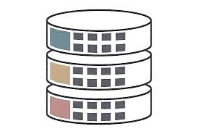
Zero-Day and Legacy Platform Vulnerabilities
A legacy platform is one that is no longer supported by its developer or vendor in terms of security patches.
This may be a personal computer, laptop, smartphone, a networking appliance, etc.
These systems are highly susceptible to exploits and must be protected through measures.
1
2

Slide 97
Weak Host Configurations
Ineffective settings in unproductive patch, configuration policy, and procedures can have significant effects.
Default Settings
Avoid relying on the vendor to ship products with a secure default
configuration
Incorrectly configured network appliances can make the system more open and prone to attacks

Slide 98
Weak Host Configurations
Unsecured Root Accounts
It allows threat actor to have complete control and restricts login for superuser.
Open Permissions
It allows unauthenticated access. Write access can be allowed with weak read access.

Slide 99
Weak Network Configurations
Weak network configuration is caused due to the following:
Open Ports and Services
It restricts attacks at network parameter using an access control list and disables unnecessary services, or block ports.
Unsecure Protocols
It enables cleartext data transmissions that are vulnerable to snooping.

Slide 100
Weak Network Configurations
Weak Encryption
It results in storage and transport encryption. Since the key is generated from weak password, the key distribution and cipher are not secure.
Errors
Error messages are thrown when the network reveals too much information.

Slide 101
Weak Network Configurations
Generic steps for hardening services to meet a specific role include:
Step 1
Step 2
Restrict access to the service by IP address or address range for security critical resources.
Disable any services that have been installed by default but are no longer required.
Step 3
Restrict access to ports at border firewalls for services that should be available only on the private network.

Slide 102

Third-Party Risks
High-profile breaches have increased the awareness of the supply chain's role in vulnerability management. Third-party risks are generated through:
Outsourced code development
Supply chains
Vendor management
Cloud based and on- premise risk
Data storage

Slide 103

Third-Party Risks
Vendor management is a process for identifying potential suppliers and assessing the risks associated with third-party products or services.
When it comes to data and cyber security, it is critical to understand that risks cannot be transferred entirely to the vendor.

Slide 104

Third-Party Risks
Outsourced Code Development - Effective oversight is particularly pertinent when it comes to outsourced code development.
Without in-house programming expertise, it is difficult to ensure that contractors deliver secure code.

Slide 105
Third-Party Risks
Risks of Cloud-Based vs. On-Premises Computing
Cloud-Based
On-Premises Computing
On-premises risks include software vulnerabilities, insecure configurations, and third-party issues caused by hosts, servers, routers, switches, access points, and firewalls connected to a private network in private offices or campus buildings.
The cloud service provider as well as the cloud consumer is accountable for cloud security.

Slide 106

Third-Party Risks
There are two primary scenarios in which data is at risk when third parties are used.
Precautions that should be taken in general while dealing with third parties are as follows:
Provide data with the same level of protection
Monitor and audit third-party access to data storage
Conduct a compliance assessment of the implications of storing personal data on a third-party system

Slide 107
Vulnerability Scanning Techniques

Slide 108
Security Assessments Framework
Reconnaissance and discovery on the network are used to determine hosts, network topology, and open services or ports, thereby establishing an attack surface.
Numerous types of security assessments can be used to check for vulnerabilities in these hosts and services.
01
Security assessments can be conducted using a variety of models and frameworks.
02

Slide 109

Security Assessments Framework
SP 800-115 identifies three primary assessment activities:
Conducting tests on the object being assessed to identify vulnerabilities
1
Examining assessment objects to gain a better understanding of the security system and identify any logical flaws
2
Conducting interviews with employees to elicit information and
ascertain their attitudes and understanding toward security.
3

Slide 110
Security Assessments Framework
Vulnerability assessment, threat hunting, and penetration testing are the three primary types of security assessment.
A vulnerability assessment is a process that evaluates a system's security and ability to comply with regulatory requirements based on its current configuration state.
Vulnerability assessment determines whether the current configuration is consistent with the ideal configuration.

Slide 111
Vulnerability Scan Types
A fully automated scanner must be configured with signatures and scripts. There are numerous types of vulnerability scanners, each optimized for a specific task. They include:
Scanners for network vulnerabilities
Scanners for applications
and web applications
A network vulnerability is used to assess the security of network hosts, such as client PCs, mobile devices, servers, routers, and switches.
A dedicated application scanner is configured to scan for known attacks, missing patches, and vulnerable configurations.

Slide 112
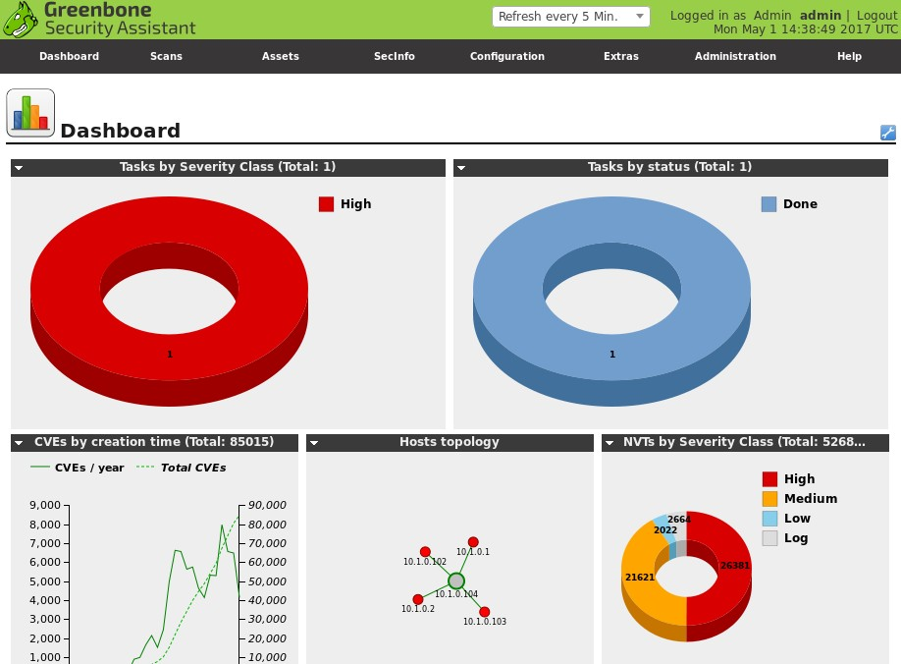
Vulnerability Scan Types
Screenshot of a vulnerability assessment tool is given below:

Slide 113
Common Vulnerabilities and Exposures
An automated scanner must be kept active with information on newly discovered vulnerabilities that include:
Security Content Automation Protocol (SCAP)
Vulnerability feed or plug-in or test
Common Vulnerabilities and Exposures (CVE)
Common Vulnerability Scoring System (CVSS)

Slide 114
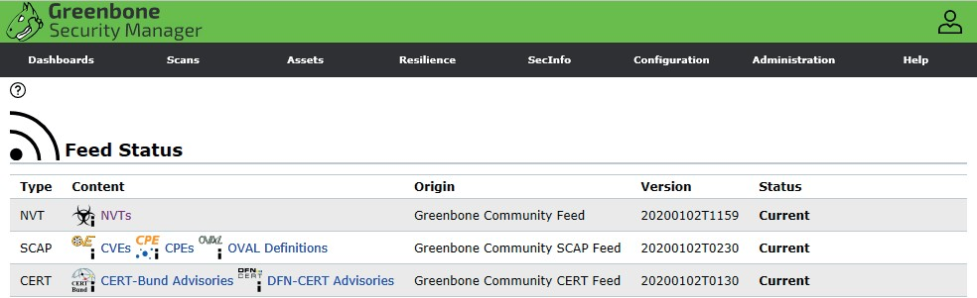
Common Vulnerabilities and Exposures
Screenshot of a vulnerability feed or plug-in or test is given below:

Slide 115

Common Vulnerabilities and Exposures
Components that are a part of vulnerability's entry in the CVE include:
A string of at least four digits in the format CVE-YYYY-####
A succinct description of the flaw
A reference list of URLs where additional information about the vulnerability can be found
The creation date of the vulnerability entry

Slide 116

Common Vulnerabilities and Exposures
The CVE dictionary is the primary source of information for the National Vulnerability Database maintained by NIST (nvd.nist.gov).
The NVD provides additional analysis, a criticality metric calculated using the Common Vulnerability Scoring System (CVSS), and fixes information in addition to the CVE descriptions.

Slide 117
Intrusive vs. Non-Intrusive Scanning
Intrusive or active scanning
Non-intrusive scanning
Non-intrusive scanning passively tests
security controls.
The scanners attach to network and only sniff traffic.
It has low host interaction.
Intrusive or active scanning establishes
network sessions.
Agent-based scans are done in intrusive scanning.

Slide 118
Exploitation Frameworks
Features of exploitation frameworks:
1
High intrusive or risk of system crash
2
Used with penetration testing

Slide 119
Credentialed vs. Non-Credentialed Scanning
Credentialed
Non-credentialed
Scans configured files
Allows privileged access to configuration settings/logs/registry
Uses dedicated account for scanning
Allows anonymous or guest access to
host
Tests Might test default passwords

Slide 120
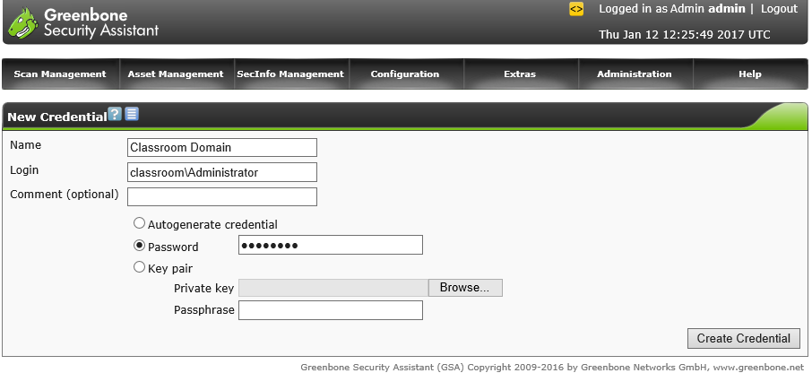
Credentialed vs. Non-Credentialed Scanning
The image below shows the Greenbone OpenVAS vulnerability scanner with security assistant web application interface as installed on Kali Linux.

Slide 121

Threat Hunting
It is an assessment technique that uses threat intelligence insights to determine whether TTPs are already present on the network or system.
A pen test aims to achieve system intrusion or a concrete demonstration of a vulnerability. Threat hunting relies solely on data analysis within the system.

Slide 122
Threat Hunting
While leading the threat hunting process, senior security analysts must analyze:
Advisories and bulletins
The publications of security bulletins and advisories by vendors and security researchers regarding new TTPs and vulnerabilities may serve as the impetus for establishing a threat hunt.
Intelligence fusion and threat data
A TTP and IoC threat data feeds are used to keep the analytics platform active.
Maneuver
Maneuver is a military doctrine term that refers to the process of acquiring a positional advantage.

Slide 123
Penetration Testing Concepts

Slide 124
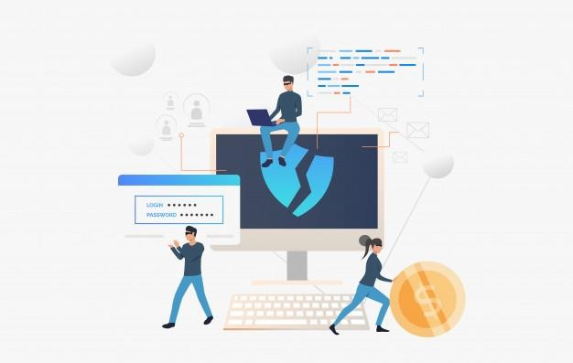
Penetration Testing
Pen test uses authorized hacking techniques to uncover exploitable vulnerabilities in a target's security systems.
Pen testing is referred to as ethical hacking.

Slide 125

Penetration Testing
The following steps may be included in a pen test:
Verify the existence of a threat
1
Bypass security controls
Actively test security controls
4
2
3
Exploit vulnerabilities

Slide 126




Rules of Engagement
Authorization is needed to proceed from system owner and affected third-parties. To establish this the following is used:
Agreement for objectives and scope
Authorization to proceed from system owner and
affected third-parties
Attack profile
Bug bounty programs

Slide 127

Rules of Engagement
Attack profile can be distinguished as:
Black box (unknown environment)
White box (known environment)
Gray box (partially known environment)

Slide 128
Exercise Types
Red team
Performs the offensive role
Blue team
Performs the defensive role
White team
Sets the rules of engagement and monitors the exercise
Purple team
Exercises set up to encourage collaboration

Slide 129
Passive and Active Reconnaissance
TTPs established a variety of kill chain models describing the pattern of modern cyber-attacks.
Reconnaissance activities fall into two categories:
Passive Reconnaissance
Active Reconnaissance
Active techniques may include gaining physical access to a target's premises or scanning the target's web services and other networks with scanning tools.
Passive reconnaissance is unlikely to alert the investigation's target, as it entails querying publicly available data.

Slide 130

Passive and Active Reconnaissance
Five processes of Passive and Active Reconnaissance are:
Drones and war flying
01
02
Open-Source
Intelligence (OSINT)
War driving
03
04
Social engineering
05
Footprinting

Slide 131

Pen Test Attack Life Cycle
The reconnaissance phase of a kill chain attack is followed by an initial exploitation phase in which a software tool is used to gain access to the target's network.
After establishing a foothold, the pen tester can begin securing and expanding the access.

Slide 132
Pen Test Attack Life Cycle
The different stages of penetration testing include:
1
2
3
Initial exploration
Persistence
Privilege escalation
8
7
6
5
Actions on
objectives
Lateral movement
Cleanup
Pivoting

Slide 133

Guidelines for Conducting Security Assessments
When considering the use of security assessments, keep the following guidelines in mind:
1
Identify the procedures and tools required
2
Create a configuration and maintenance strategy
2
Conduct scans and review the results

Slide 134
Guidelines for Conducting Security Assessments
4
Schedule configuration reviews and remediation plans
5
Implement threat hunting programs
6
Conduct penetration testing exercise and establish clear rules of engagement
7
Conduct penetration tests by following a structured kill chain life cycle

Slide 135
Key Takeaways
Nmap is a network scanning tool that uses IP packets to locate all connected devices and provides information on the running services and operating systems.
Nmap users can detect services, versions, and fingerprint in an operating system.
Vendor management is a process of identifying potential suppliers and assessing the risks associated with third-party products or services.
The CVE dictionary is the primary source of information for the National Vulnerability Database maintained by NIST.

Slide 136
Identifying Social Engineering and Malware

Slide 137
Learning Objectives
By the end of this lesson, you will be able to:
Classify contrast social engineering techniques
Analyze indicators of malware-based attacks
Outline phishing and spam
Illustrate pharming and credential harvesting

Slide 138
Classify Contrast Social Engineering Techniques

Slide 139
Social Engineering
Social Engineering is the exploitation of human behavior and trust.
01
Social engineer predates on people's intrinsic wants and needs.
It is a strategy that relies on human emotion, deceptive tricks, and outright lies.
02
04
03
They are more knowledgeable of attributes and tailor their attacks accordingly.

Slide 140
Social Engineering
Examples of typical social engineering interference scenarios:
An intruder impersonates a remote sales agent who wants help in setting up remote access and contacts the help desk.
2
An attacker generates an executable file that asks a user for their password and records whatever they type.
An intruder sets off a fire alarm and connects a surveillance system to a network port while everyone is distracted.
1
3

Slide 141
Social Engineering Principles
Social engineering attacks rely on one or more of the following principles to be persuasive:
Familiarity or Liking
Consensus or Social Proof
It creates trust.
It makes the request appear reasonable and natural.
It utilize courteous behaviors.
It creates fabricated testimonials or contacts.

Slide 142
Social Engineering Principles
Authority and Intimidation
Scarcity and Urgency
It makes the target fearful of refusing.
It takes advantage of a lack of knowledge or awareness.
It convinces the target to make a choice.

Slide 143
Impersonation
Impersonation refers to the act of assuming another person’s identity. It utilizes:
The persona to entice or intimidate
Situations where establishing identity is difficult

Slide 144

Pretexting and Trust
Pretexting
It uses a scenario with convincing additional detail.
Trust
It obtains or spoofs data that support the identity claim.

Slide 145

Dumpster Diving
Dumpster diving is a practice of stealing document and media from trash.

Slide 146
Tailgating and Piggybacking
Tailgating refers to the technique of illegally accessing a protected area.
Piggybacking
It is an act of entering a protected area with approval of an employee.
It is used by an insider threat actor to gain access without being logged.

Slide 147


Identity Fraud and Invoice Scams
Identity fraud
To provide compelling information or spoofed proofs, impersonation is feasible.
It distinguishes the identity theft and identity fraud.
Invoice scams
Spoofing supplier details to submit invoices with false account details

Slide 148
Identity Fraud and Invoice Scams
Credential theft and misuse includes:
01
Credential harvesting: Account information from past attacks are commonly available in credential databases.
02
Shoulder surfing: A user is being watched while typing a password or PIN.
03
Lunchtime attacks: Attacker physically gains access to the device once the user leaves the workstation unattended.

Slide 149


Phishing
Phishing is the hybrid of social engineering and spoofing.
It tricks the target into interacting with a malicious resource masked as a trusted entity,
typically via email as the vector.
The user's login credentials are recorded as they authenticate with the spoofed site.

Slide 150
Phishing
The different types of phishing techniques include:
Spear phishing: It is a phishing scam where the attacker has data that allows an individual target more likely to be tricked by the attack.
Whaling: It is a spear phishing attack directed specifically against upper levels of management in the organization.
Vishing: It is a phishing attack conducted through a voice channel.
Smishing: It refers to the use of text communications via simple message service as the vector.

Slide 151

Spam
Attacks that use unsolicited email is known as spam. It involves:
Threat actors
Email address harvesting
Spam over Internet Messaging (SPIM)

Slide 152
Hoaxes
It includes security warnings or chain emails that are often coupled with phishing attacks.
Fake A-V used to get the user to install remote desktop software
2
Delivered as spam or malvertising
Phone-based scams
1
3

Slide 153
Prepending
Prepending a phishing or hoax email makes a more compelling mail system. It refers to inserting text that appears to be created, scanned, and approved by security software.
It involves:
1
2
Using threat actor as a consensus or urgency technique
Tagging email subject line
3
Using mail systems to warn users

Slide 154
Pharming and Credential Harvesting
Passive techniques have less risk of detection. It includes:
Pharming
Typosquatting
Uses cousin domains instead of redirection
Makes phishing messages more convincing
Refers to redirection by DNS spoofing

Slide 155
Pharming and Credential Harvesting
Watering hole
Credential harvesting
Focuses attacks on obtaining credentials for sale rather than direct intrusion
Concentrates attacks on obtaining multiple credentials for a single company
Targets a third-party site.
Includes customer, supplier, hobbies, social media, etc.

Slide 156
Indicators of Malware-Based Attacks

Slide 157



Malware
Malicious software or malware is used in many intrusion attempts against computer networks. They are classified vector or infection method as:
Potentially Unwanted Programs (PUPs)
Viruses and Worms
Trojans
Malicious code used for spying the processes in a system
Pre-installed bloatware
Not completely concealed
Also called grayware
Harmful codes that execute automatically

Slide 158
Computer Viruses
It is a form of malware that is designed to replicate and propagate from one computer to another by infecting executable programs or code. The different types of viruses include:
Non- residentor file infector
Memory resident
Multipartite
Script and macro viruses
Boot

Slide 159
Types of Viruses
Non-resident or file infector
The virus is embedded in a host executable file and executes alongside the host method.
Memory resident
The virus establishes a new process in memory when the users run the host file.
Boot
When the OS starts or the media is connected to the machine, the virus code is written to the disc boot sector.

Slide 160
Types of Viruses
Script and macro viruses
The malware takes advantage of programming features in local scripting engines for the OS.
Multipartite
Viruses that use several vectors are referred as multipartite. Viruses that dynamically alter or obfuscate their code to avoid detection are referred to as polymorphic.

Slide 161
Computer Worms and Fileless Malware
01
Computer worms: They propagate in memory or over network link. They consume bandwidth and may be able to compromise application or OS to deliver payload.
Fileless malware: It exploits remote execution and memory residence to deliver payloads.
02

Slide 162
Features of Fileless Malware
Runs from an initial script or Trojan
1
Exploits living off the land of built-in scripting tools
Offers persistence via the registry
4
2
3
Uses shellcode to create backdoors and downloads tools

Slide 163


Spyware and Keyloggers
The subject of the first viruses and worms was the destructive potential to reproduce.
The different ways of malware monitoring are discussed below:
Tracking cookies
Adware (PUP or grayware)
Are created by adverts and analytics widgets embedded into websites
Are in the form of a program, a browser extension, or plugin
Changes the browser settings

Slide 164


Spyware and Keyloggers
Spyware
Keylogger
Logs all local activity
Triggers recording devices and screenshots
Initiates redirection
Records keystrokes to capture
sensitive information

Slide 165
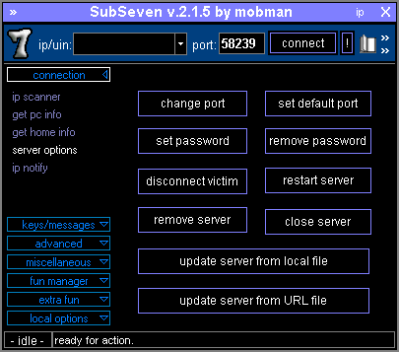
Backdoors and Remote Access Trojans
A backdoor is a form of access method for a host that bypasses the normal authentication method and gives the remote user administrative power.

Slide 166

Backdoors and Remote Access Trojans
The types of backdoors include:
Backdoor malware
Remote Access Trojan (RAT)
Bots and botnets Command and Control (C2 or C&C)
Backdoors from misconfiguration and unauthorized software

Slide 167


Rootkits
It refers to a malware that can only be installed manually in Windows with local administrator rights. The user must trust the installer package enough to enter passwords.
The trojan uses a registry entry or builds itself as a service to ensure persistence that can be detected quickly.

Slide 168
Rootkits
The process of rootkits includes the following components:
Local administrator versus SYSTEM or root privileges
1
Firmware rootkits
Replaceable key system
files and utilities
4
2
3
Purge log files

Slide 169
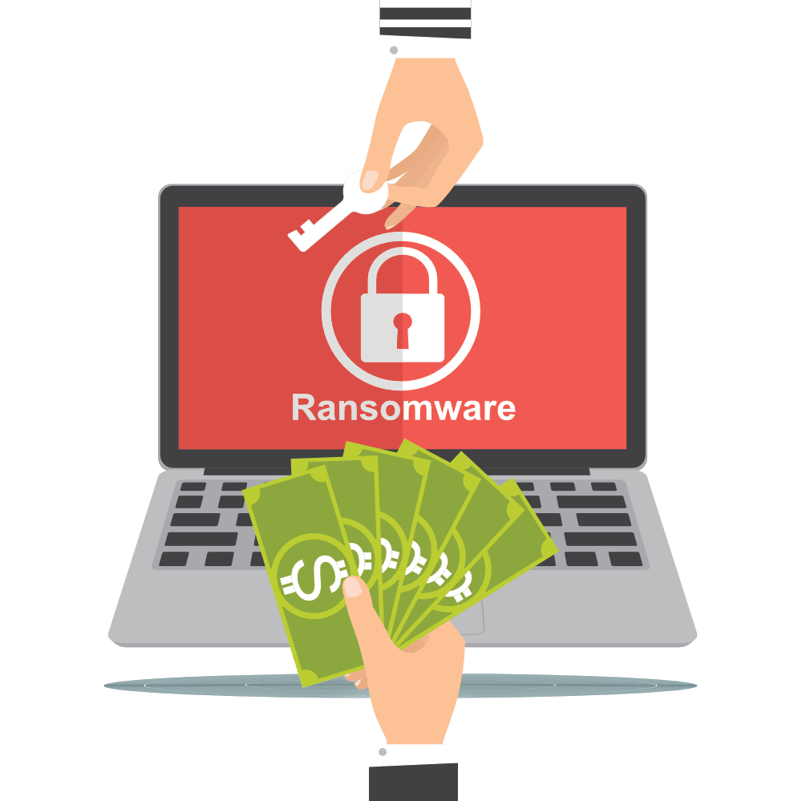
Ransomware and Crypto-Malware
Ransomware is a form of malware that attempts to extort money from its target.
Crypto-malware is a form of ransomware that encrypts data files on fixed, removable, and network drives. It is a high impacting ransomware (encrypt data files or drives).
It shows offensive messages like demanding the reactivation of Windows.

Slide 170

Crypto Mining and Logic Bombs
Crypto Mining or Cryptojacking refers to the complexity of performing the necessary calculations to analyze the total number of coins in a cryptocurrency.
Logic bomb malware does not initiate automatic attacks. It waits for a pre-configured time, date, device, or user event after infecting the system.
Malware code is not needed for logic bombs.

Slide 171
Malware Indicators
With a variety of malware styles, there are a plethora of possible indicators. They include:
Anti-Virus Notifications
Anti-Virus (A-V) program should be installed on most hosts. These suites are best defined as
Endpoint Protection Platforms (EPPs) or next-generation anti-virus.
Sandbox Execution
Sandbox is a device that helps to disconnect infected endpoint from its host that will help prevent malware break out.

Slide 172
Malware Indicators
Resource Consumption
It refers to a performance monitor, task manager, or the top Linux utility used to detect abnormal resource usage.
File System
File system changes and anomaly analysis are required to protect the systems.

Slide 173
Key Takeaways
The classic impersonation attack involves the social engineer calling into a department, claiming they need to make a remote adjustment to the user's system.
Identity fraud is a form of impersonation in which the perpetrator uses precise information about another person's identity.
Malware is typically characterized as software that does something wrong from the perspective of the device owner.
Rootkits are malwares that can only be installed manually in
Windows with local administrator rights.

